Slide 1
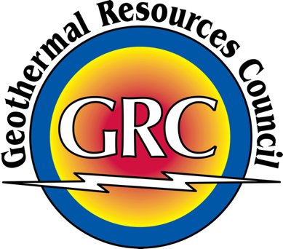
Initial Results from the 2020 U.S. Geothermal Power Production and District Heating Market Report
Jody C Robins
GRC Annual Meeting
10/19/2020
Notes:
Hello, my name is Jody Robins. I am a senior geothermal engineer at NREL. Today, I will be presenting the initial results from our forthcoming 2020 U.S. Geothermal Power Production and District Heating Market Report

Slide 2
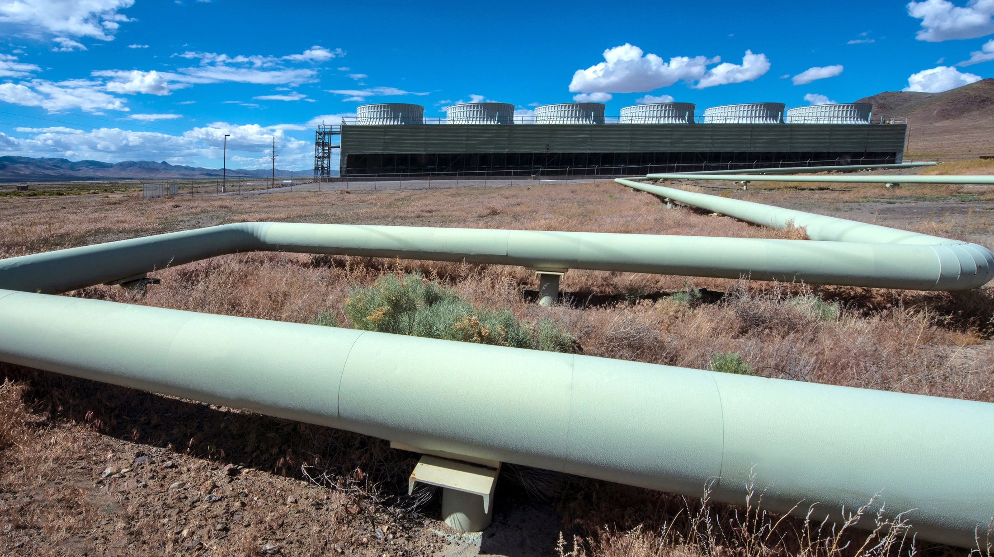
2020 Market Report
Developed by team from NREL and GRC with financial support from the GTO and GRC.
Provides geothermal stakeholders with up-to-date U.S. power production and district heating data.
Evaluates the impact of state and federal policy and presents current research on geothermal development.
Notes:
The Report is being developed by NREL and the GRC, with financial support from the Geothermal Technologies Office of the U.S. DOE and the GRC. It is intended to provide geothermal policymakers, regulators, developers, researchers, and other stakeholders with up-to-date information reflecting the 2019 geothermal power production and district heating markets in the United States. It will also present analysis of the current state of the U.S. geothermal industry and markets for both the power production and district heating sectors, with special consideration of developing power projects. In addition, the report will evaluate the impact of state and federal policy, present current research on geothermal development, and offer a future outlook for the U.S. geothermal industry. Data for the 2020 report have been compiled from previous GEA reports, the U.S. Energy Information Association, and from a GRC industry survey conducted in 2020 via a questionnaire sent to all known companies operating U.S. geothermal power plants or with projects in development.
The following presentation is a summary of the U.S. power production and developing project data collected for the 2020 report.

Slide 3







Project Team
Jody Robins
NREL
Francisco Flores-Espino
NREL
Amanda Kolker
NREL
Hannah Pauling
NREL
Will Pettitt
GRC
Brian Schmidt
GRC
Koenraad Beckers
Heateon
Notes:
Here you can see the project team, which is primarily composed of researchers from NREL and the GRC.

Slide 4
50 Years of U.S. Geothermal Deployment
*Mean net generation: an effective capacity value calculated by dividing actual geothermal generation by the total hours in a year
*
Sources: EIA 2019a, EIA 2019b, and Matek 2016
Notes:
As you can see on this slide, Geothermal capacity and generation in the US have grown little over the past 5 to 6 years. In fact, the Summer and winter net generating capacity have actually declined over this time. Mean net generation, which is an effective capacity value calculated by dividing the actual geothermal generation by the total hours in a year, has also remained relatively flat.

Slide 5
U.S. Geothermal Power Production Fleet Age
Older geothermal plants and fields tend to experience a reduction in capacity.
Currently 44% of U.S. geothermal plants representing 64% of capacity are more than 30 years old.
In 2009, 4% of U.S. geothermal plants representing 11% of capacity were more than 30 years old.
Notes:
One consequence of the lack of geothermal capacity growth is that with relatively few new plants being built, the U.S. geothermal power production fleet has aged. Currently, 44% of U.S. geothermal plants are more than 30 years old, which represents 64% of the total US geothermal nameplate capacity. This in comparison to 2009 when only 4% of US plants representing 11% of the capacity were more than 30 years old. Thus, as older geothermal plants and fields tend to experience a reduction in capacity, the relatively advanced age of the geothermal fleet at least partially accounts for the previously noted capacity stagnation.

Slide 6
U.S. Geothermal Capacity by Plant Technology
Trend: Most new plants in the U.S. are environmentally friendly binary plants.
Notes:
This figure displays the US geothermal capacity by plant technology type. It shows how dry steam and flash technology formed the foundation of the U.S. geothermal power production capacity in the 70s and 80s. However, almost all geothermal capacity additions from 2000 through 2020 have been binary plants. While binary technology allows for lower temperature resources to be used and produces almost no emissions, the capacity of a binary plant is inherently smaller than a plant using the older technologies. Thus, beginning in 2013, essentially all capacity gains from new binary plants have been offset by decreases in the capacity of the older steam and flash plants.

Slide 7
U.S. Geothermal Projects in Development
Projects categorized as “prospects” are early in development, and projects in Phase 4 are nearing completion.
Only 2 projects from 2016 GEA developing project list have been completed.
Notes:
This slide represents Information on geothermal projects in development collected from GRC’s 2020 industry survey. Projects categorized as “prospects” are early in development, and projects in Phase 4 are nearing completion. Currently, Geothermal companies operating in the United States have a combined 58 active projects and prospects across nine states. Of these projects, five are in Phase 4. Unfortunately, only 2 projects from 2016 GEA developing project list were eventually completed and put online.

Slide 8
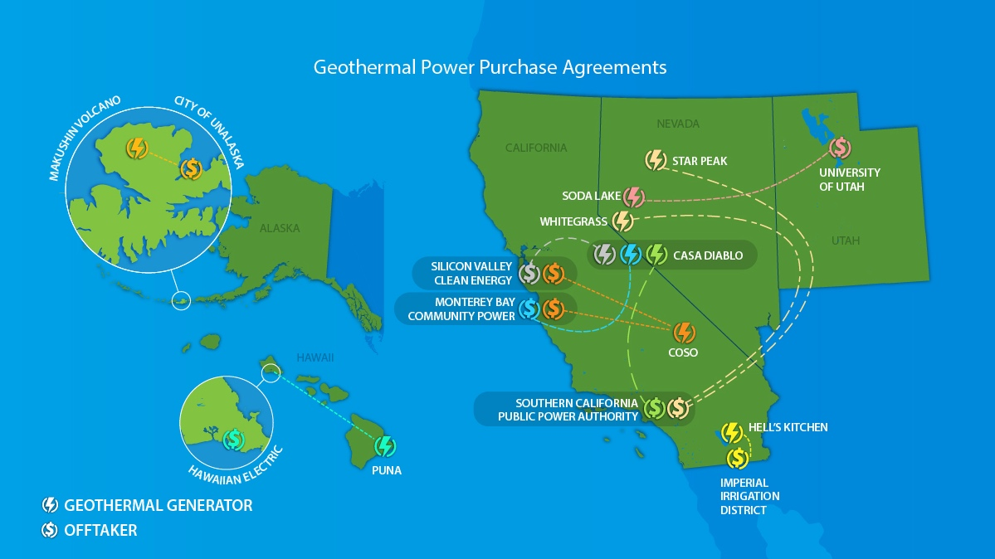
Future Outlook
Notes:
Although recent geothermal industry power generation numbers have been relatively flat, there is reason to expect capacity growth in the near future. As you can see here, nine new geothermal PPAs have already been signed since late 2019 across the American West and in Hawaii and Alaska.

Slide 9



Future Outlook
19
2
9
New Geothermal
MWe
CAPACITY
online in Nevada:
Steamboat Hills expansion
not included in report data
New Geothermal
Power
Plants
to be built in California:
  Casa Diablo IV
  Hell’s Kitchen
New Geothermal
Power Purchase Agreements
signed since late 2019:
Utah (1), Hawaii (1),
Alaska (1), California (6)
Notes:
In addition to these PPA’s, Ormat has recently brought 19 MW of additional capacity online in their Steamboat Hills expansion, which was not included in the report data. Also, included in the PPAs are plans for the first two geothermal power plants to be built in California in a decade.
So, while the US geothermal industry has hit something of a speedbump over the last 5 years, I think there is reason for optimism that industry growth will increase in the near future.

Slide 10
Thank You
NREL/PR-5500-77434
Contact Information: jody.robins@nrel.gov
This work was authored in part by the National Renewable Energy Laboratory, operated by Alliance for Sustainable Energy, LLC, for the U.S. Department of Energy (DOE) under Contract No. DE-AC36-08GO28308. Funding provided by the U.S. Department of Energy Geothermal Technologies Office and the Geothermal Resources Council. The views expressed in the article do not necessarily represent the views of the DOE or the U.S. Government. The U.S. Government retains and the publisher, by accepting the article for publication, acknowledges that the U.S. Government retains a nonexclusive, paid-up, irrevocable, worldwide license to publish or reproduce the published form of this work, or allow others to do so, for U.S. Government purposes.
Notes:
Please keep an eye out for our forthcoming 2020 U.S. Geothermal Power Production and District Heating Market Report forthcoming
Thank you for your time and enjoy the rest of the conference.

